Slide 1
Introduction to R
Mostafa Reisi Gahrooei

Slide 2


Installation
can be downloaded from the Comprehensive R Archive Network (CRAN) mirror site for free:
http://cran.r-project.org/
In ‘Download and Install R’ section, click to choose between Linux, Mac OS and Windows, then follow the (rather different) instructions.
RStudio
RStudio is a free and open source integrated development environment for R. It can be downloaded from:
http://www.rstudio.com/

Slide 3
The R Console Window
The command line prompt (>) is an invitation to start typing in commands or expressions.
R evaluates and prints out the result of any expression that is typed in at the command line in the console window.
Multiple commands may appear on the one line, with the semicolon (;) as the separator.

Slide 4
The R Console Window
When working, you will sometimes see + at the left-hand side of the screen instead of >. This means that the last command you typed is incomplete.
If you can see what is missing (e.g. a final right-hand bracket), just type the missing character and press enter. Then the command will execute.
If you have made a mistake, then press the Esc key and the command line prompt > will reappear.
Use the Up arrow key to retrieve your last command.

Slide 5
Getting Help in R
If you know the name of the function you want help with, type a question mark ? followed by the name of the function, or use help().
>?read.table
>help(read.table)
If you only know the subject on which you want help, use help.search(“"):
>help.search("data input")
If you are connected to the internet, you can type CRAN in Google
and search for the help you need at CRAN.

Slide 6
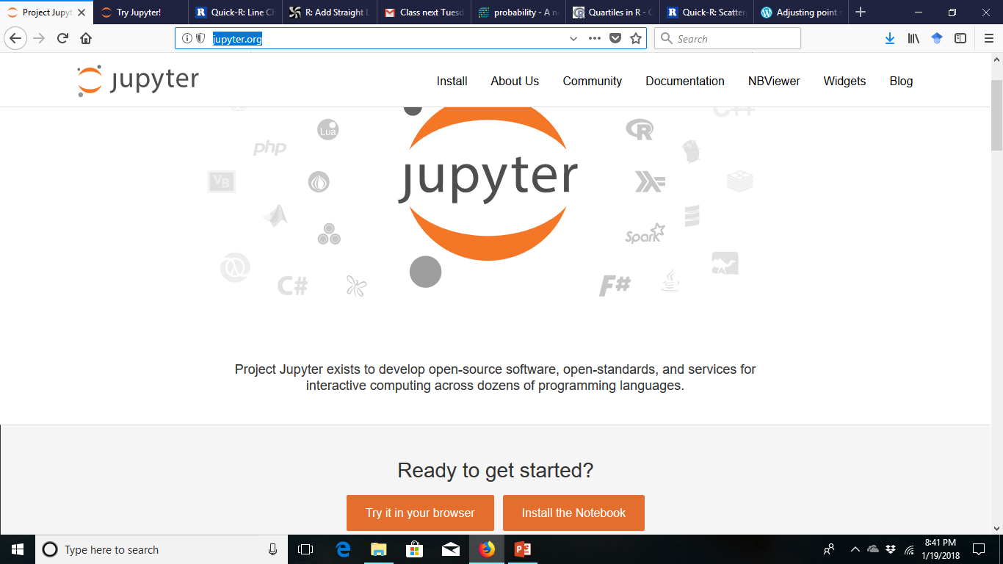
Jupyer
In our lecture we are going to use Jupyter as our platform:
http://jupyter.org/
You can either intall Jupyter or use it in your browser.

Slide 7
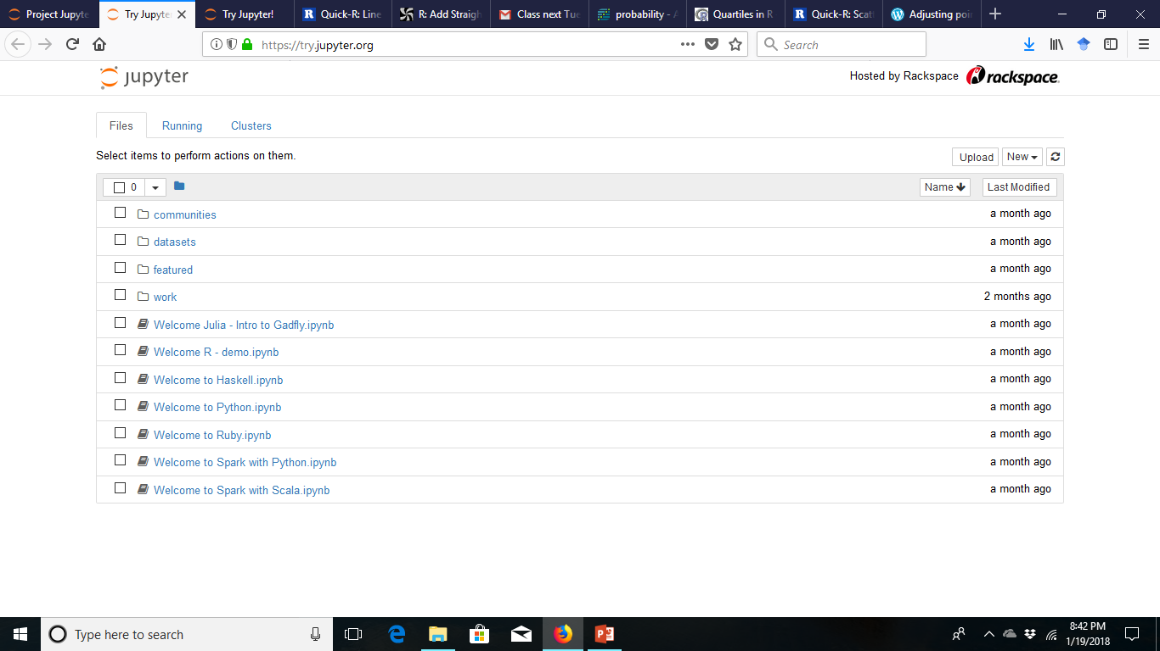
Jupyter
Press on upload to upload a new notebook
Or press new to choose your programming language, e.g., R
The file format is .ipynb

Slide 8
Variable Names
Variable names in R are case-sensitive so x is not the same as X.
Variable names should not begin with numbers (e.g. 1x) or symbols (e.g. %x).
Variable names should not contain blank spaces: use back.pay (not back pay).

Slide 9
Data Frames
A data frame is a more general object than a matrix, in the sense that different columns may have different modes (different types of data).
All elements of any column must, however, have the same mode, that is, all numeric, or all factor, or all character, or all logical.

Slide 10
Lists
Recall that for data frames, the data in different columns could be of different types but had to have the same structure (i.e., have the same length).
Lists are a construct that allow you to tie together different types of data that do not share the same structure.

Slide 11
Exercise 1
Generate 1000 values from standard normal distribution. We treat this as our population.
Find the mean and std of the population.
sample 100 values from the population.
find the mean and std of the sample
plot the boxplot of population and sample in a same plot.

Slide 12
Exercise 2
Generate data from three normal distributions, call z1, z2, and z2
Plot the histogram of summation of these three variables.
Square the values and add them up call the new variable x
Plot the histogram and boxplot of x
Find the mean, median and std of x

